Slide 1
Dimentionality reduction and the Principal Component Analysis
https://www.youtube.com/watch?v=FgakZw6K1QQ

Slide 2
Dimensionality reduction

Slide 3
Why we reduce dimensions
Because the high dimensionality of the data sets implies a significant implementation time of EDA procedures.
Because the greater the dimensionality, the more elements of the set should be taken into account to make the results representative.
Above all:
Because in multidimensional sets there are phenomena inherently associated with them, collectively referred to as the "curse of dimensionality". It turns out that even simple operations - such as finding the closest neighbor - yield unexpected results.

Slide 4
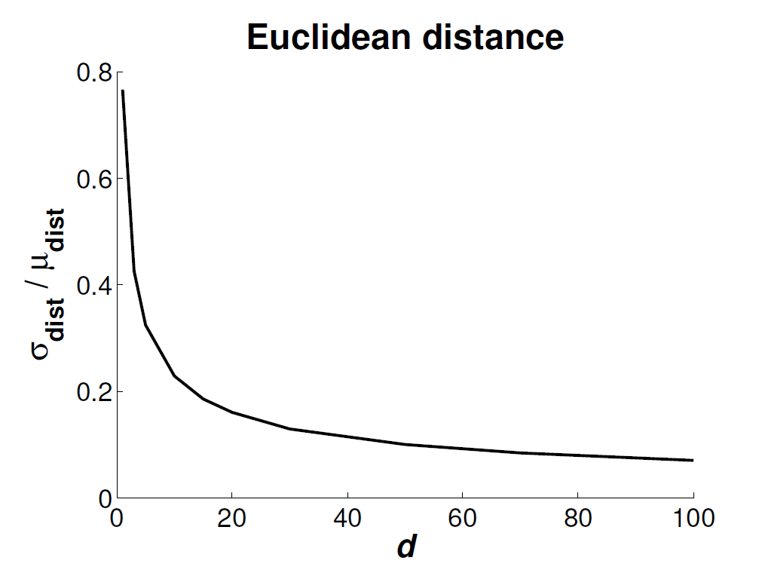
Example, concentration of distances

Slide 5
Feature selection != Feature reduction
Feature selection – we only choose some features from the data set
Feature reduction – we transform the features by creating new features which consist of „old features” so we transform the original data, but we do not get rid of any of the features

Slide 6
Methods of dimensionality reduction classification
A. The nature of the relationship
linear, i.e. Y = X A
non-linear ie Y = f (X) often not explicitly given
(b) The degree of interaction
unsupervised
supervised
(c) Unambiguity of mapping
general
point-to-point
and few others…

Slide 7
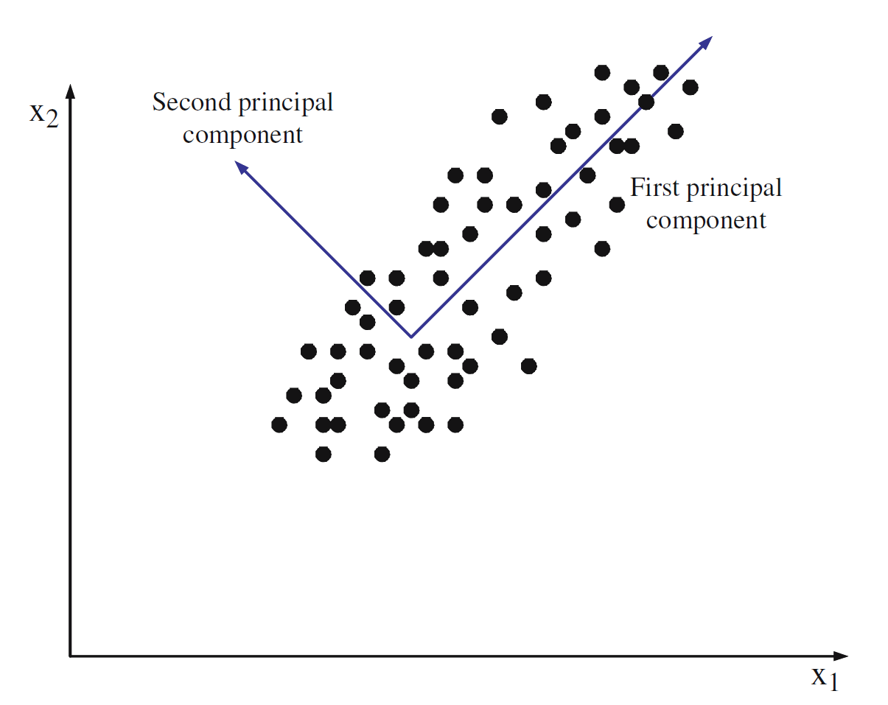
PCA

Slide 8
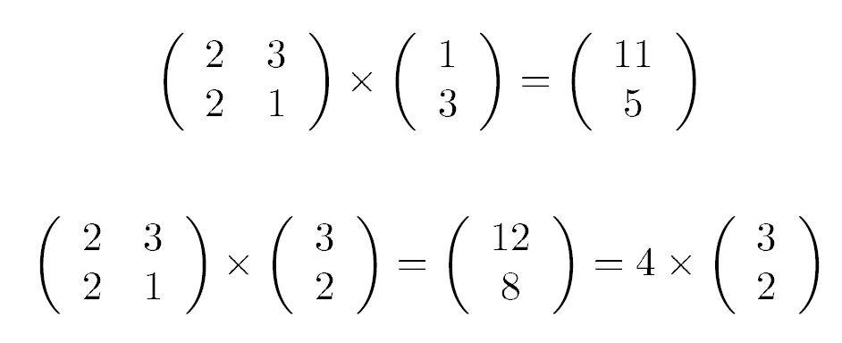
How to find the PC vectors?
We are looking for elements of the matrix A [Nxn] such that the data projected on the transformation axis represented by it will maximize the variance.
We assume that the data set is normalized in such a way that µ is a zero (null) vector.
It turns out that we find the matrix A by finding the eigenvectors of the covariance matrix cov (X).
What is an eigenvector?

Slide 9
Calculation of eigenvectors
By definition, the vector Ai is called the eigenvector of the covariance matrix if:
The matrix A consists of n eigenvectors placed in the rows, each of them being orthogonal to the others and the associated eigenvalue λi corresponds to the variance in the direction of this vector. The mere multiplication by such a "full" matrix corresponds to the rotation of the set so that one of the axes (the so-called main component) is with the axis with the maximum variance.
To get the eigenvector, first get the eigenvalues ​​from the characteristic equation:

Slide 10
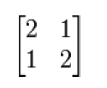
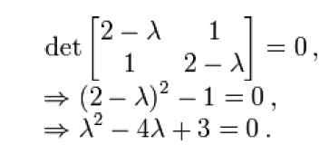


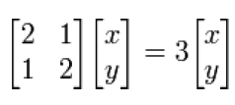




Calculation of eigenvectors

Slide 11
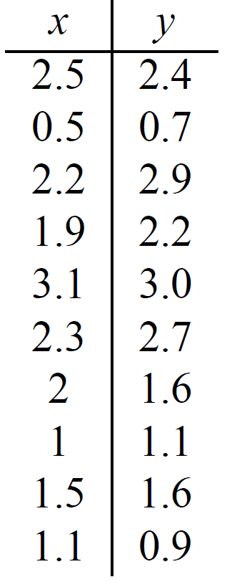
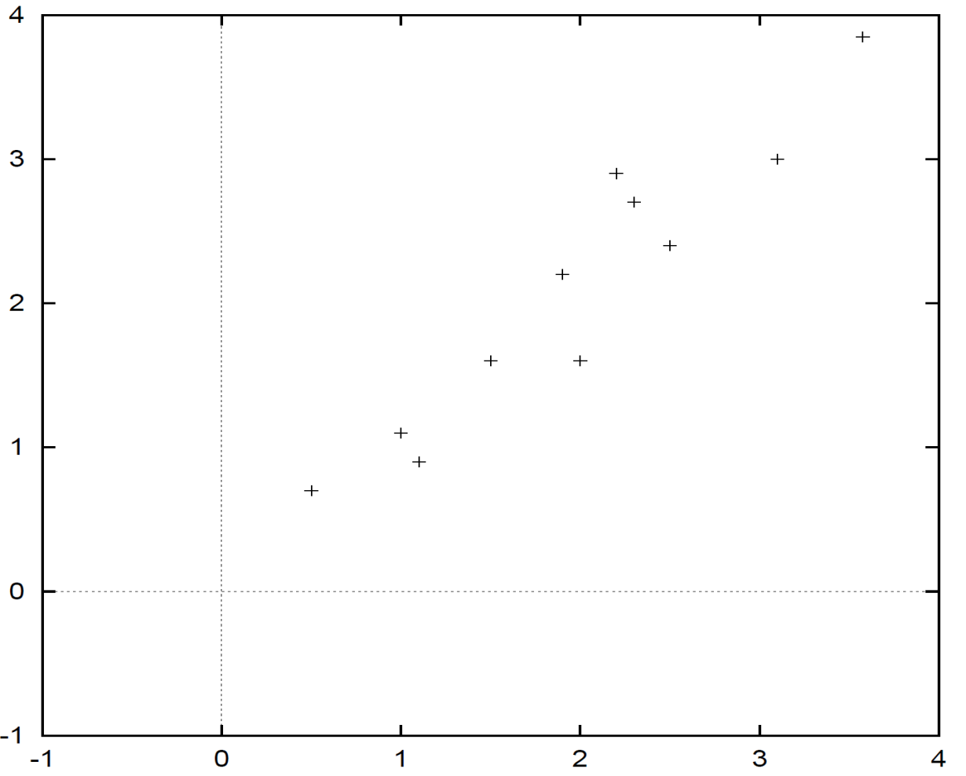
PCA - example

Slide 12
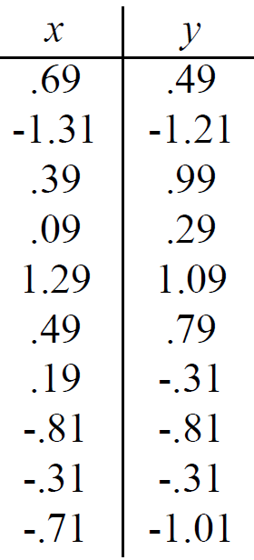
PCA - example

Slide 13
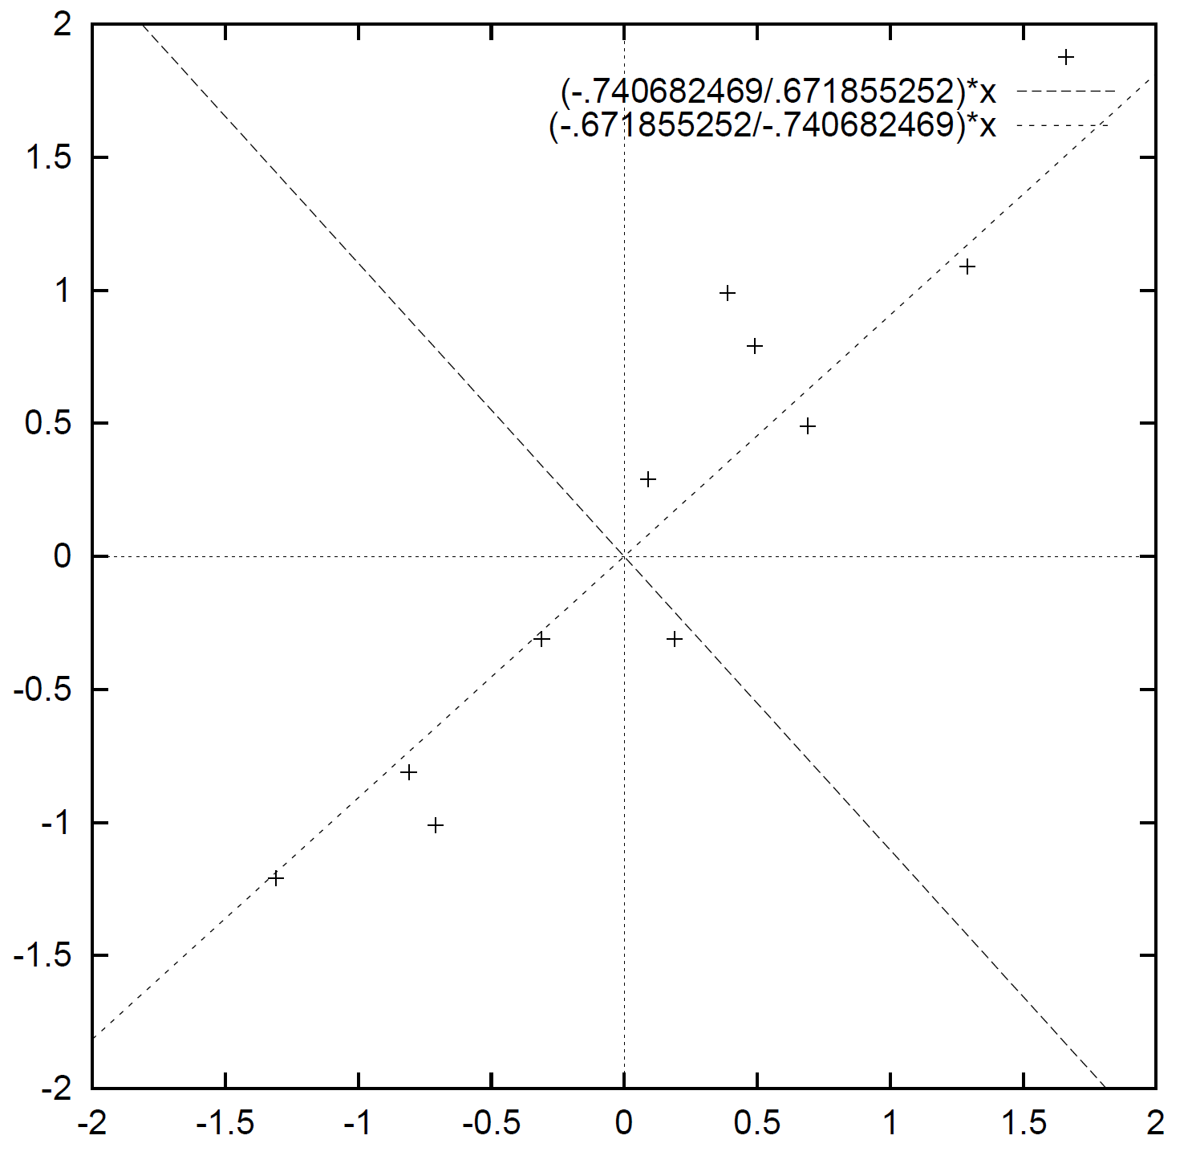
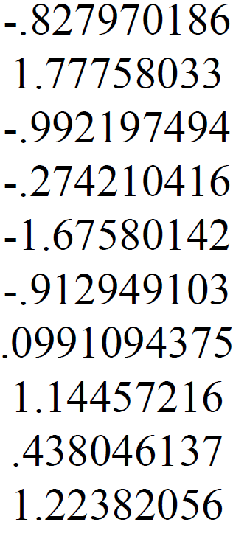
PCA – casting over PC1 and PC2

Slide 14
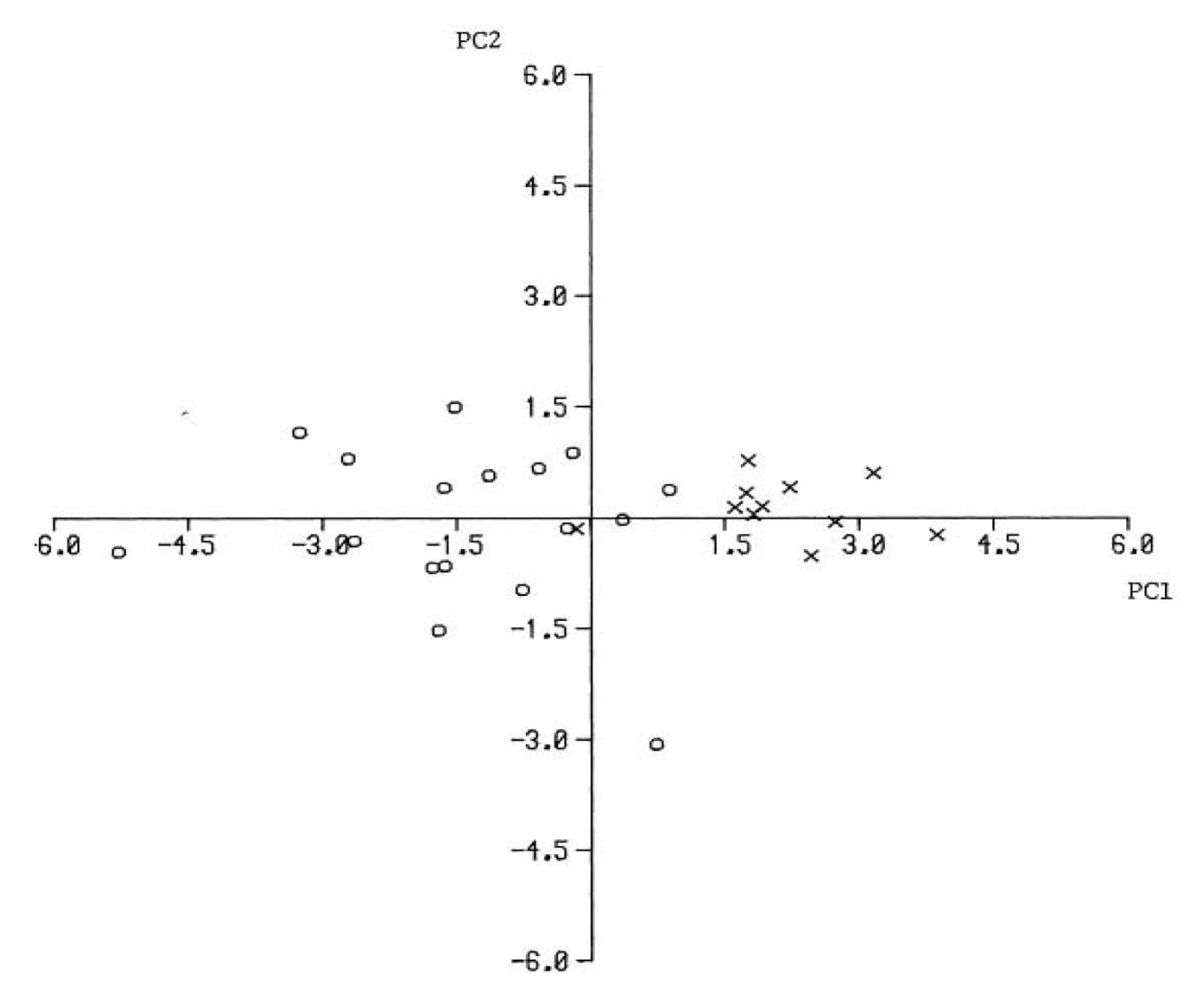
PCA – example 2
PC1 – 80% of variance explained with PC1

Slide 15
Multi-dimentional scaling
Multidimensional scaling (Young, Householder, 1938; Torgerson 1952) is a group of dimension reduction / visualization methods that attempts to preserve the distance (called distance preservation) between points in the original and reduced space. This is done by minimizing an indicator called stress:
Since MDS only operates on distances, it does not really require specific point locations from the original set. The transformation performed by MDS is point-to-point and is not explicitly given.

Slide 16
Non-linear Sammom mapping
Nonlinear Sammon Mapping is the most widely used MDS variant with a well-defined optimization engine and character cost index:
In order to minimize this indicator, a modified iterative Newton algorithm is used. The rule for updating the position of each point is implemented as follows (α = 0.3 ÷ 0.4):

Slide 17
NSM – procedure
1. Find all distances between the elements of the set.
2. Determine initial positions of points in the reduced space - either randomly or using eg PCA.
3. Find the offset value for each set point.
4. Update point locations.
5. Do 3 - 4 until the stress value does not decrease.

Slide 18
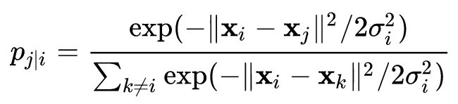
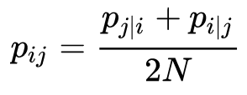
t-SNE
t-SNE - t-Distributed Stochastic Neighborhood Embedding - modification of the original SNE algorithm, developed by Laurens van der Maaten (2008). It is based on the concept of preserving the local data distribution.
SNE:
For two points in the primary space 𝑥_𝑖 and 𝑥_𝑗, the probabilities determining their similarity are determined:
wherein:
and the sum of 𝑝_𝑖𝑗 after all 𝑖, 𝑗 is 1. The parameter 𝜎_𝑖𝑗 is selected on the basis of the so-called perplexity (number of neighbors - generally in the range of 5-50).

Slide 19
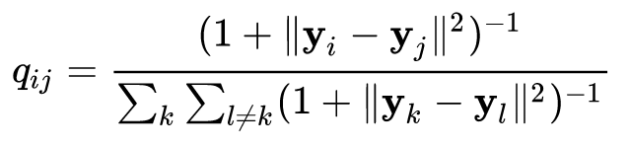
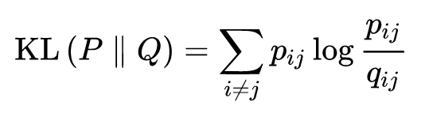
t-SNE
Similar probabilities can be defined in the reduced space:
And all the magic - we set 𝑦_𝑖 in such a way as to minimize the coefficient of divergence of Kullback-Leibler distributions:
t-SNE uses the t-Student distribution instead of the Gaussian distribution.

Slide 20
t-SNE illustration
https://www.oreilly.com/content/an-illustrated-introduction-to-the-t-sne-algorithm/

Slide 21
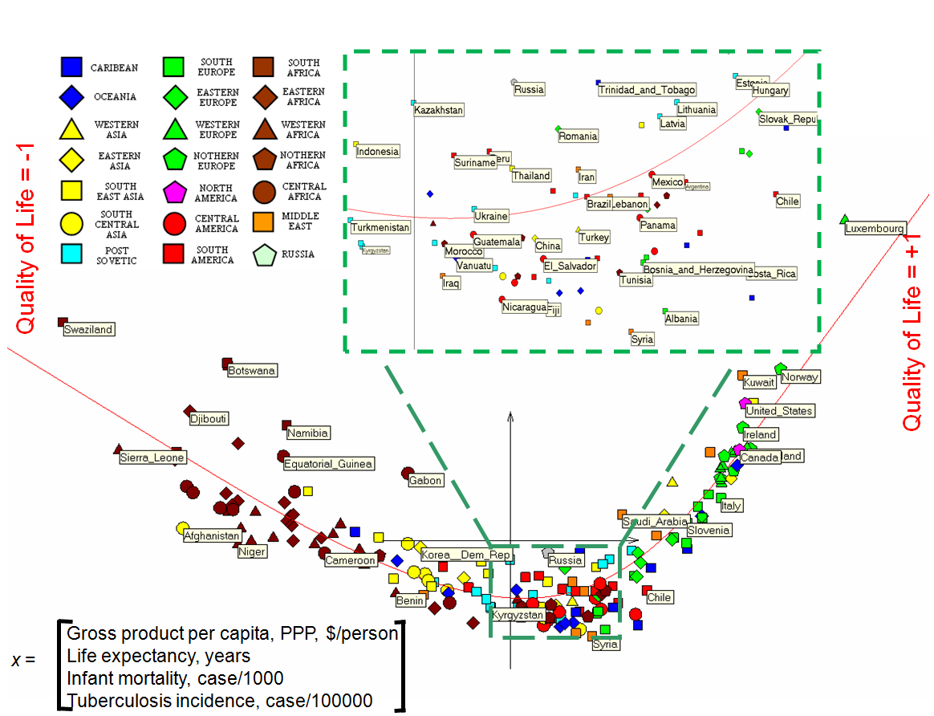

Slide 22
PCA – graphical explanation

Slide 23

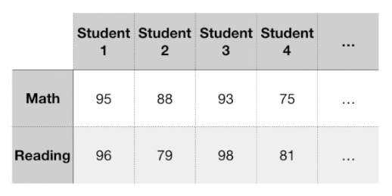
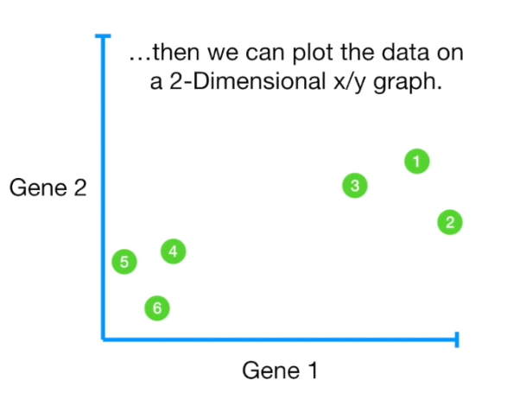
Let us imagine a data set…
W
We can see that points create 2 clusters.

Slide 24
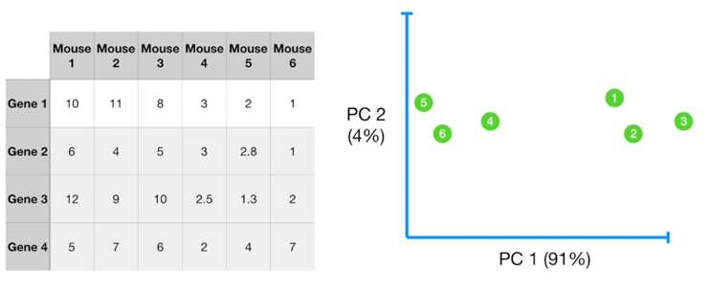
For 4 features, we cannot plot data any more, unless we apply the PCA technique

Slide 25
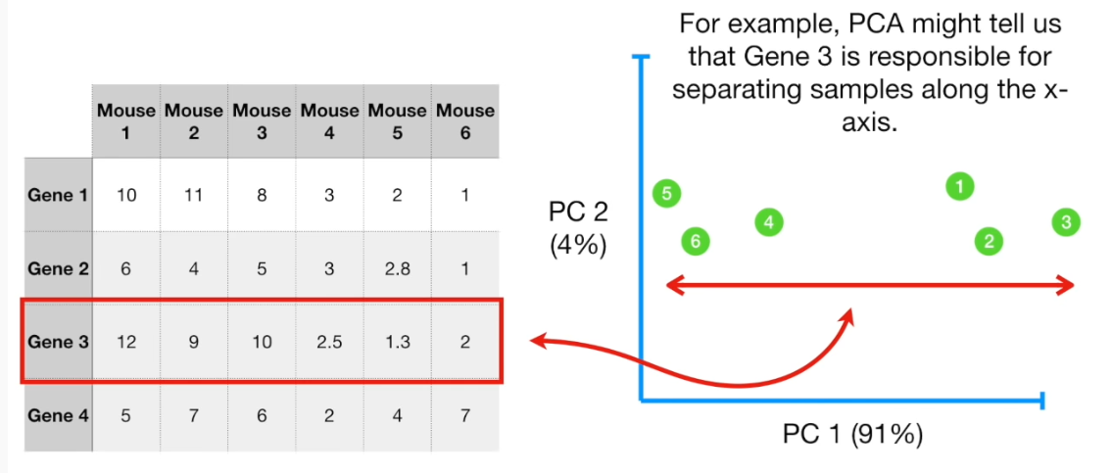
PCA helps to reduce dimentions, but at the same time it helps understand a data set

Slide 26
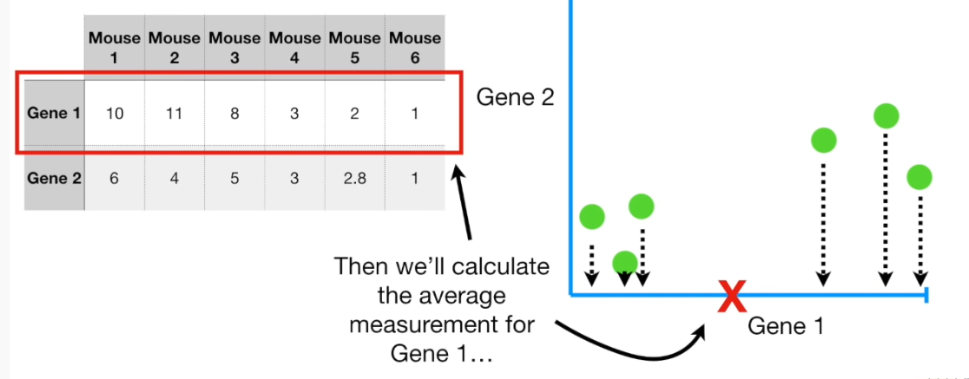
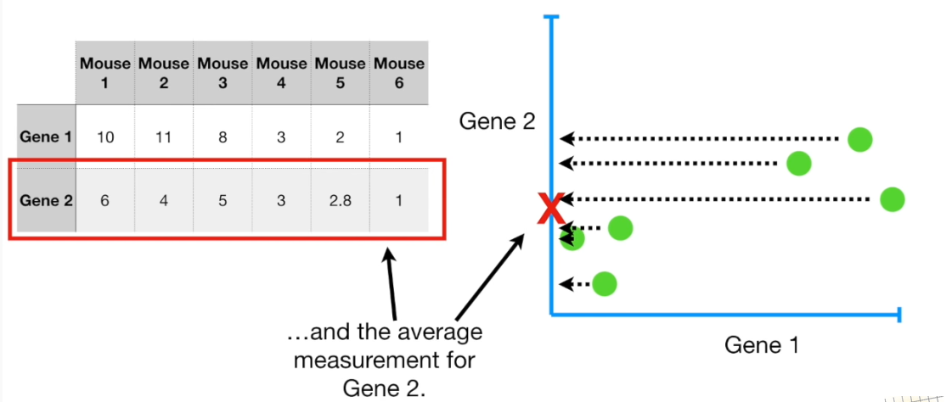
The idea of PCA (for only 2 dimensions)

Slide 27
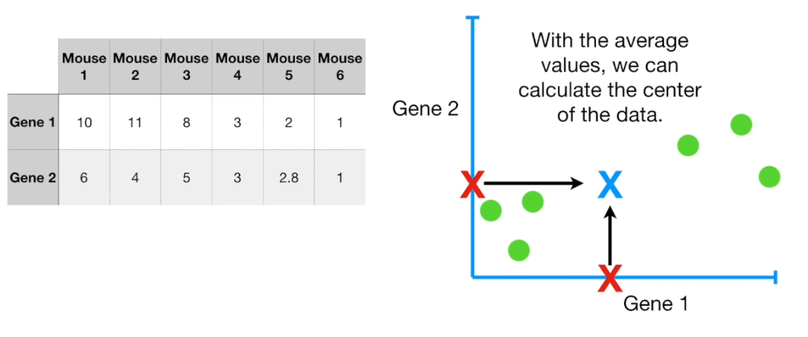
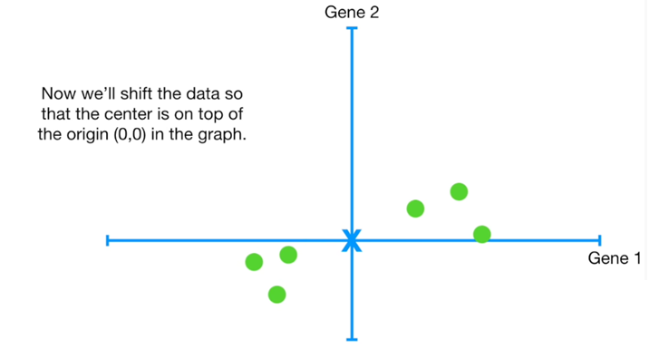
The idea of PCA (for only 2 dimensions)

Slide 28
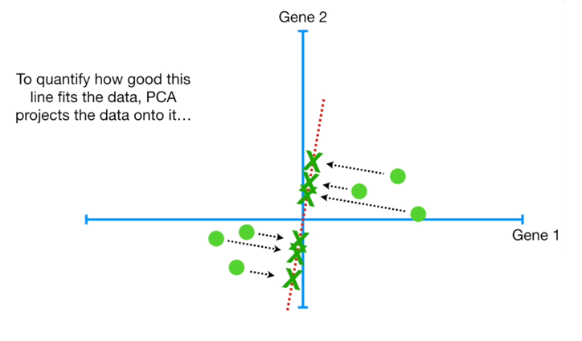
The idea of PCA (for only 2 dimensions)
We will now try to find the line which is the closest from all the points. PCA projects the points onto the line and measures distances from the points towards these projected points.

Slide 29
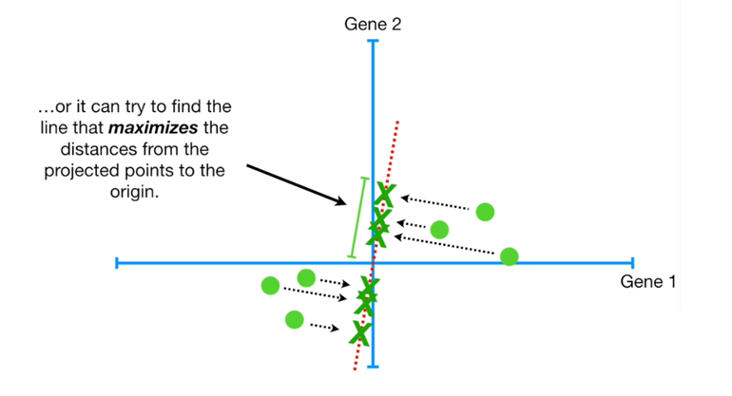
The idea of PCA (for only 2 dimensions)
Technically, PCA does not maximize distances between points and their projections. Equivalent approach is to maximize squared distances from projected points from the point of origin.

Slide 30
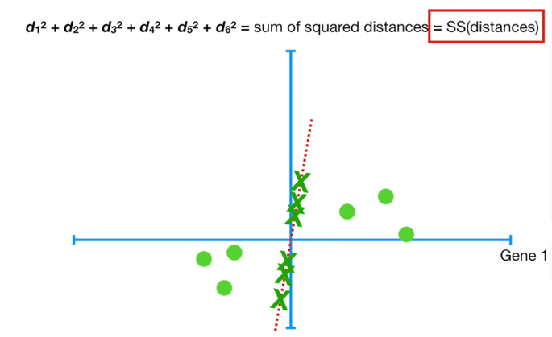
The idea of PCA (for only 2 dimensions)

Slide 31
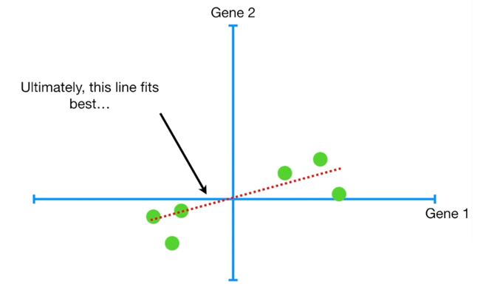
The idea of PCA (for only 2 dimensions)

Slide 32
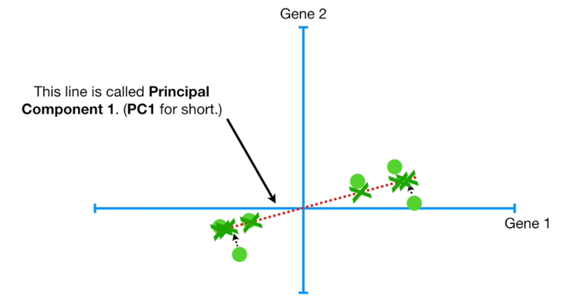
The idea of PCA (for only 2 dimensions)
The slope coefficient is 0.25

Slide 33
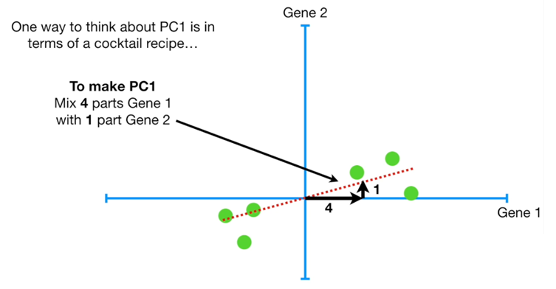
The idea of PCA (for only 2 dimensions)
So data is mostly spread out along ox (gene 1) axis and only a little bit over the oy (gene 2) axis. The ratio of ox/oy tells that ox (gene 1) is more important. Linear combination of ox and oy is 4*ox + 1 * oy.

Slide 34
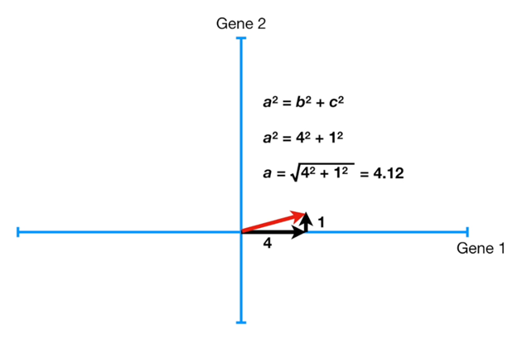
The idea of PCA (for only 2 dimensions)

Slide 35
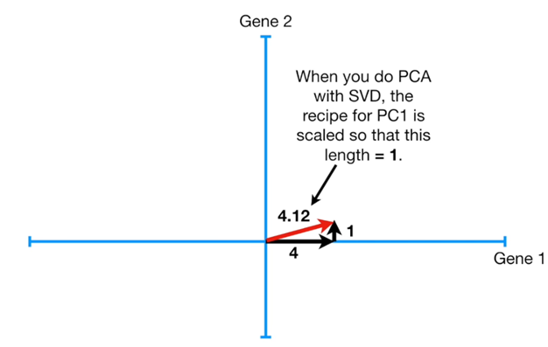
The idea of PCA (for only 2 dimensions)

Slide 36
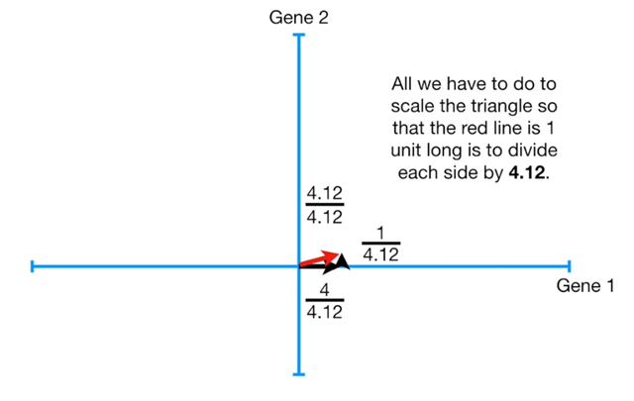
The idea of PCA (for only 2 dimensions)

Slide 37
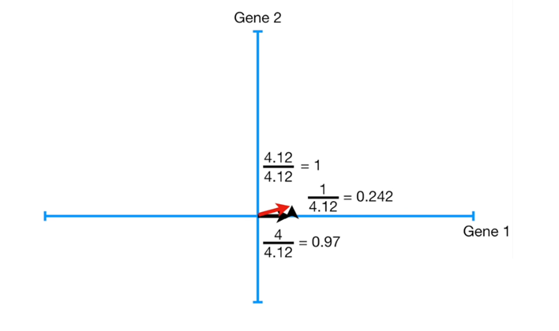
The idea of PCA (for only 2 dimensions)
Now our proportions of importance of data on ox axis (gene 1) and data on oy axis (gene 2) are: 0.97 for ox and 0.242 for oy, but the relations between them is still 4:1/

Slide 38
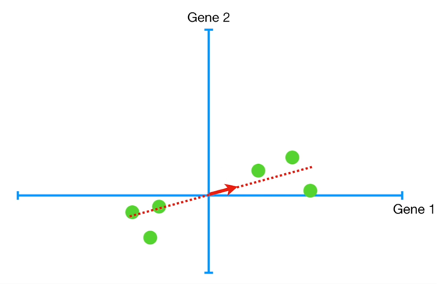
The idea of PCA (for only 2 dimensions)
This normalized vector is called the singular vector or the eigenvector for PC1. The proportions of 0.97 and 0.242 are called „loading scores”.

Slide 39
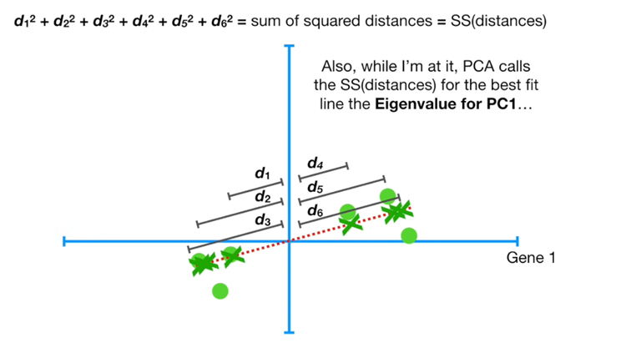
The idea of PCA (for only 2 dimensions)

Slide 40
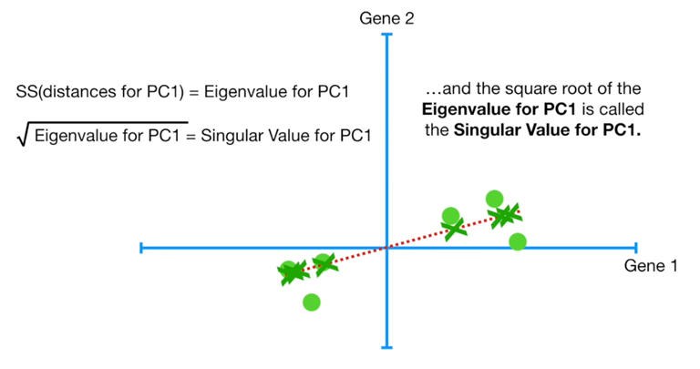
The idea of PCA (for only 2 dimensions)

Slide 41
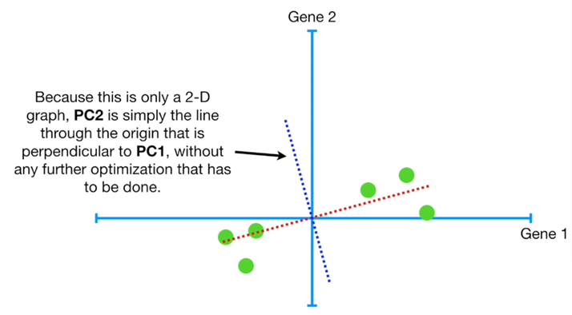
The idea of PCA (for only 2 dimensions)

Slide 42
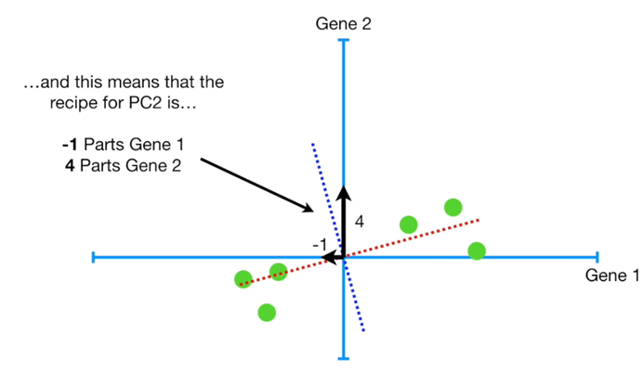
The idea of PCA (for only 2 dimensions)

Slide 43
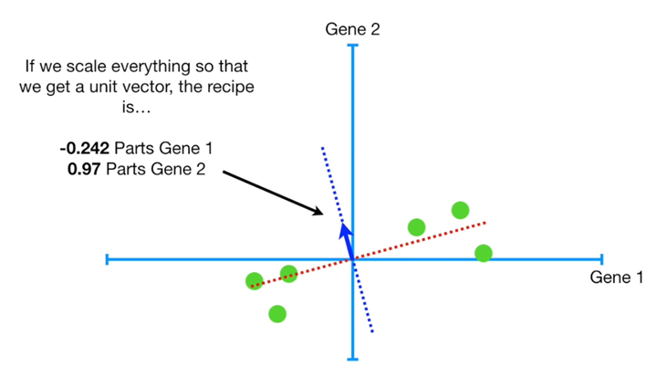
The idea of PCA (for only 2 dimensions)

Slide 44
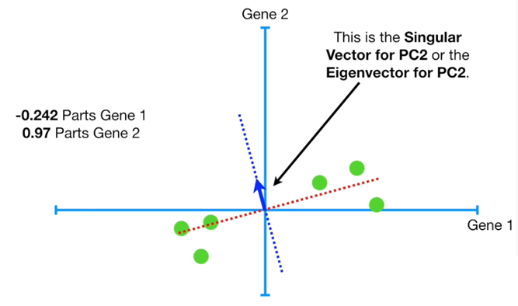
The idea of PCA (for only 2 dimensions)

Slide 45
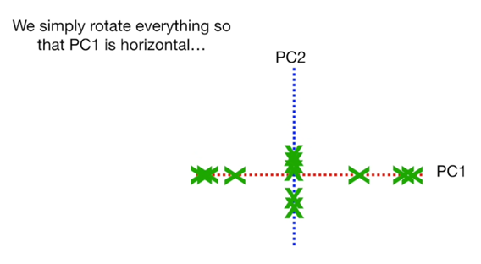
The idea of PCA (for only 2 dimensions)

Slide 46
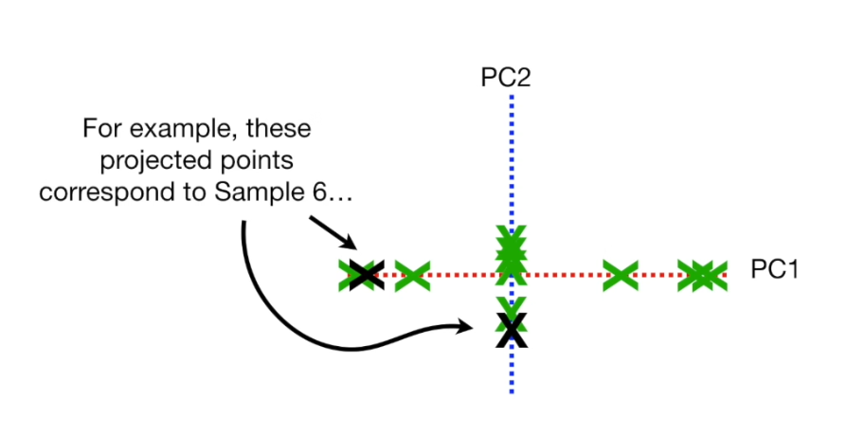
The idea of PCA (for only 2 dimensions)

Slide 47
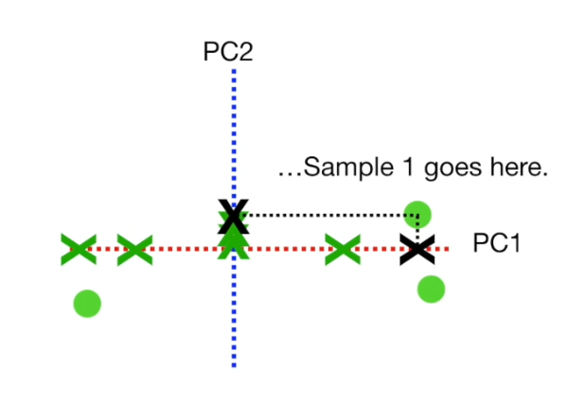
The idea of PCA (for only 2 dimensions)

Slide 48
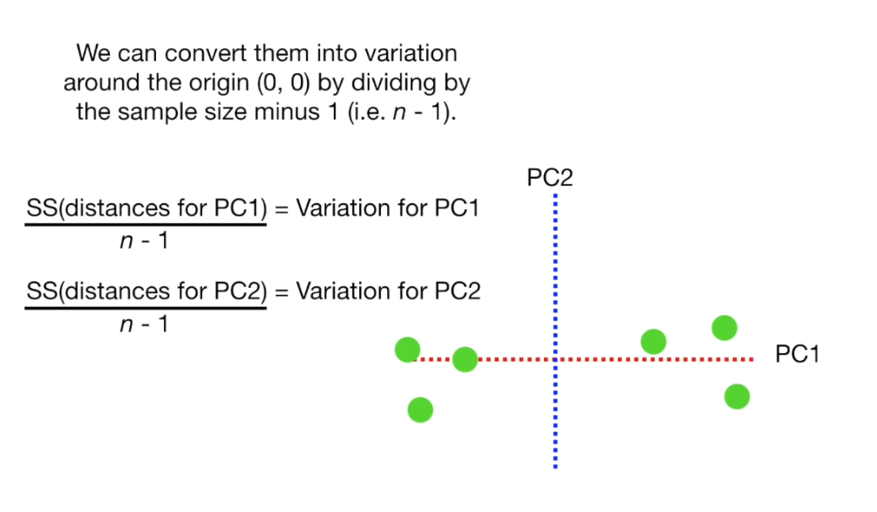
The idea of PCA (for only 2 dimensions)

Slide 49
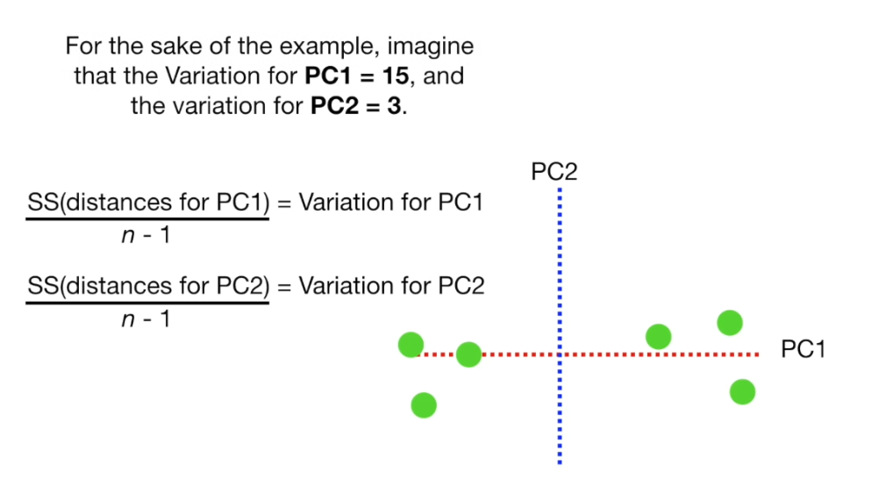
The idea of PCA (for only 2 dimensions)

Slide 50
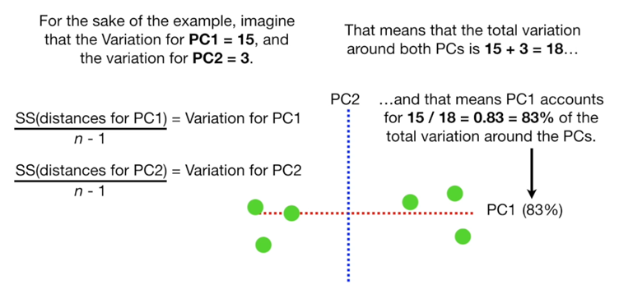
The idea of PCA (for only 2 dimensions)

Slide 51
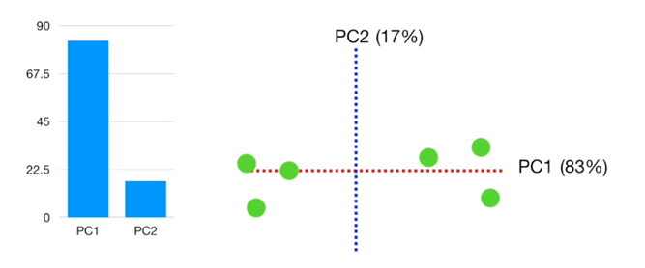
Scree plot

Slide 52
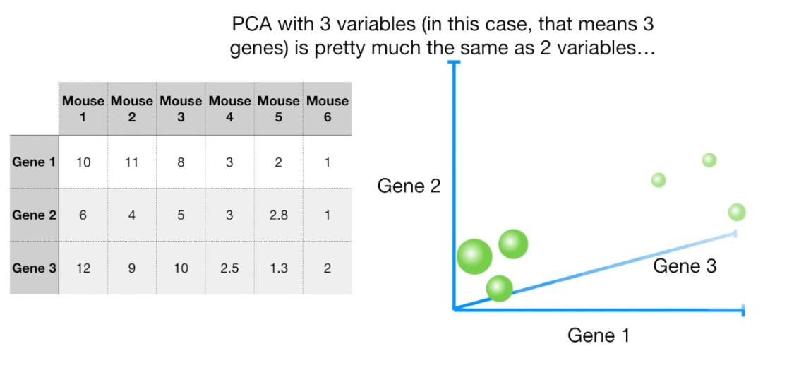
The idea of PCA (for 3 dimensions)

Slide 53

The idea of PCA (for 3 dimensions)

Slide 54

The idea of PCA (for 3 dimensions)

Slide 55

The idea of PCA (for 3 dimensions)

Slide 56

The idea of PCA (for 3 dimensions)

Slide 57

The idea of PCA (for 3 dimensions)

Slide 58

The idea of PCA (for 3 dimensions)

Slide 59
The idea of PCA (for 3 dimensions)
The number of PCs is either equal to the number of features or the number of observations, whichever is smaller.

Slide 60

The idea of PCA (for 3 dimensions)

Slide 61

The idea of PCA (for 3 dimensions)

Slide 62

The idea of PCA (for 3 dimensions)

Slide 63

The idea of PCA (for 3 dimensions)

Slide 64

The idea of PCA (for 3 dimensions)

Slide 65

The idea of PCA (for 3 dimensions)

Slide 66

The idea of PCA (for 3 dimensions)

Slide 67

The idea of PCA (for 3 dimensions)

Slide 68



The idea of PCA (for 4 dimensions)

Slide 69
RapidMiner example
Example is based on Iris data

Slide 70


Slide 71


Slide 72


Slide 74


Slide 75


